Slide 1
University of Pretoria Division: Tourism Management
AN ASSESSMENT OF THE IMPACT OF MEGATRENDS IN THE TOURISM SECTOR
15 March 2019
Berendien Lubbe
Anneli Douglas

Slide 2
Megatrends
Macroeconomic and geostrategic forces that shape the world
Slow to form
Large in scale and impact
Affect society as a whole for many years in advance
Predictable: high degree of certainty over which there is little control
Unpredictable: “Shocks and surprises” possible but high degree of uncertainty
Include some of society’s biggest challenges and opportunities
Notes:
To

Slide 3
Overall aim of the study
To identify and analyze global shifts as well as tourism specific megatrends that impact the tourism sector at a global, regional and local level, from both the demand and supply side of the sector, with a view
to develop a framework that will enable the sector to proactively respond to challenges and capitalise on opportunities for future development of sustainable tourism products and services over time.
Notes:
To

Slide 4
Phases of the study
Phase 1 - 2018/2019
Identifying the megatrends and analysing the
impact of these trends on the South African
tourism industry
Phase 2 - 2019/2020
Formulating a framework for Government and
Industry to respond to megatrends
Notes:
To

Slide 5
Phase 1 - Research Process
Literature survey
(Ongoing)
In-depth interviews
Futures Workshop
Outcomes:
Megatrends identification
Impact of megatrends under different scenarios
Defining concepts identifying theories, themes, approaches, factors, indicators
Best case analysis
Judgement sampling:
Industry sector leaders
National Policy-makers
Strategic Consultants
Futurists
Academics
Consensus on generic/essential indicators for Megatrends Framework

Slide 6
Economic Trends: Economic growth
Global economic growth will continue with improved income levels
Emerging economies (BRIC) will grow at higher level than the developed world
Africa to experience high economic growth (but number living in extreme poverty will increase)
South Africa to continue to lag behind
Notes:
To

Slide 7
Economic Trends: Tourism growth
International tourist arrivals in emerging economy destinations predicted to grow at double the rate of advanced tourism economies.
Source: UNWTO (2018)
Notes:
To

Slide 8
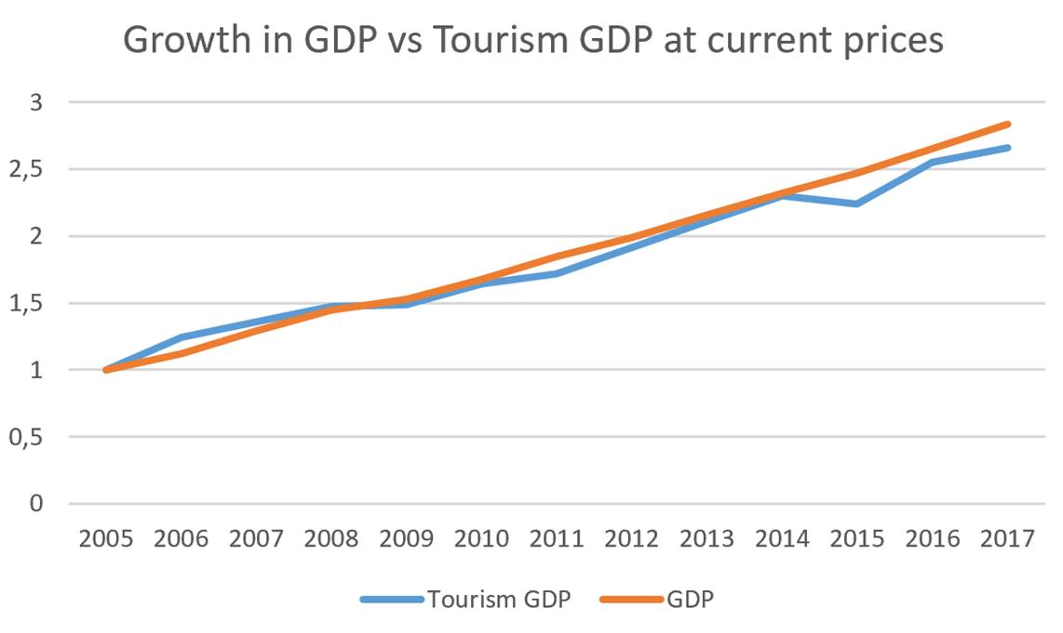
Economic Trends: Tourism growth
Globally tourism growth will outperform GDP
South Africa? Contribution of tourism to GDP decreased
2006 (3.3%) vs 2017 (2.8%)
Source: Stats SA (2018)
Notes:
To

Slide 9
Economic Trends: Tourism growth
Regionally, Southern Africa is and will continue to lag behind both North and East Africa in terms of international arrivals
China inbound not expected to grow substantially for South Africa
India to significantly contribute to expansion of tourism globally, also to South Africa (accessibility issues)
African inbound market share to increase to South Africa
Air travel continues to grow
Notes:
To

Slide 10
Economic Trends: Jobs
Tourism forecast to be one of most promising contributors to GDP growth and job creation
Increasing unemployment / youth unemployment (lack of growth, structural mismatch skills/demand, poor quality education)
More of age-appropriate population will have completed Grade 12 by 2034 (ISS) – quality?
Changing demographics will influence employment, job creation and entrepreneurship globally and in South Africa in the long term:
Ageing population – older, healthier, mentoring
Younger generations increasingly concerned with material rewards, leisure activities, mobility, flexible work hours, functioning independently
Entrepreneurship and innovation increasingly seen as key to growth
Technology will continue to impact jobs
Education must respond to the changing world of tourism with its new forms of demand and supply, new pressures and tensions and its focus on sustainability
Notes:
To

Slide 11
Political Trends
In South Africa there are more uncertainties than certainties, inhibiting investment and negatively affect tourism and jobs
Value of rand will fall (favourable for inbound) but advantage will be outweighed by deteriorating safety situation.
Global awareness increasing as more people become global citizens
Globally, there is a rise of populism, disruptive politics, potential for increased conflicts/terrorism, the shift of global economic power from advanced to emerging economies and growth of trade protectionism
Safety and security concerns increase globally, in Africa and in South Africa, affecting flow of tourists to destinations perceived as ‘safe’ being preferred
Destination accessibility increasing globally, SA processes remain inhibitive
Notes:
To

Slide 12
Social Trends
Changing demographics will influence visitor demand (growing global middle class, wealthier, ageing, multi-generational travel, high spending, substantial leisure time)
Tourists will increasingly want
sense of belonging and meaningful exchanges,
experiences and interaction with a destination and local people.
Rise of “ethnic groupings”
Niche travel will increase.
Social responsibility, justice and sustainability will become important motivators
Emerging generations (millennials and GenZ) will make up majority of domestic and international travel moving away from traditional holidays towards unique and authentic experiences.
Growing demand for accessible tourism, city tourism and business tourism.
Black travelers will become increasingly demanding for tourism products to meet their needs (domestic travel in SA)
Notes:
To

Slide 13
Technological Trends
New technologies reshaping sectors and markets (Sharing economy, IoT, Autonomous vehicles, AI, Big data analytics
Speed and magnitude of travel increasing
Travel more accessible and efficient:
Reconceptualization of middlemen - more travellers using technological platforms to link directly with suppliers.
Social media and UGC becoming most influential and extensively used for travel information, influencing the tourists’ purchase path.
New technology in transport reducing cost and increasing speed of travel and accessibility to destinations.
Technology will impact job creation (or losses) in South Africa
Notes:
To

Slide 14
Environmental Trends
Climate change will influence preferred destinations
Rising pressure on many destinations’ water resources
More emphasis on inclusive tourism
Growing use of tourism as a tool for social integration
Greater emphasis on measuring sustainability initiatives.
More awareness on combatting “over-tourism”.
SDGs will increasingly drive national tourism agendas
Notes:
To

Slide 15
From trends to futures
Four scenarios were developed that depict the possible direction of the tourism industry in South Africa. In preparation of these scenarios there was consensus by participants that there will be changes affecting tourism in terms of global and local economic growth, challenges in developing an environmentally sustainable tourism industry, potential challenges in meeting changing demand driven by new markets, changing tastes and the pervasiveness of technology as well as pressures on infrastructure development, particularly through channels of international and local investment.
Four scenarios were developed
Two goals were identified to reach a best case scenario by 2030:
Competitiveness
Sector cohesion

Slide 16
A competitive tourism destination has the sustained ability to increase tourism expenditure and capacity to attract visitors while providing them with satisfying, memorable and unique experiences in a profitable way, while enhancing the well-being of residents and preserving the natural capital of the destination for future generations, within a changing macro environment
Sector cohesion provides for planning and policy-making to achieve inclusivity and stability in the sector. Initiating integration involves coordination of sectoral initiatives to help define national adaptation priorities

Slide 17
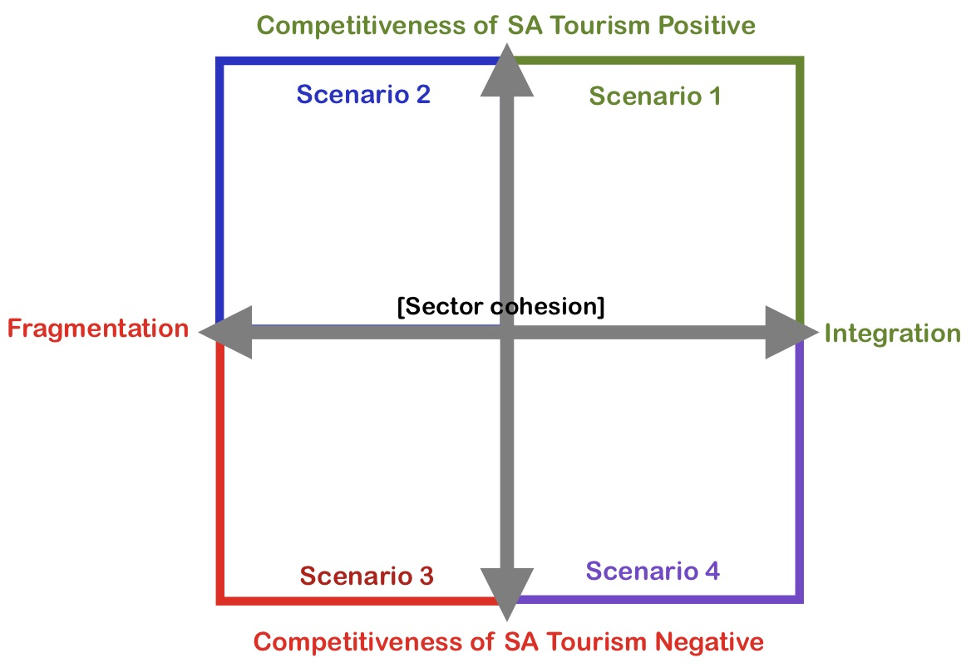
The South African Tourism Scenarios
Best case
Current?
Worst case

Slide 18
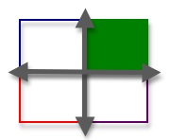
Scenario 1 - The best-case scenario An integrated tourism sector within a South Africa that is competitive with respect to tourism.
Industry has transformed
Economy is growing
Unemployment has decreased
Unrest and crime, has decreased
Industry is inclusive and sustainable,
Global and domestic investment for infrastructure development
Visitor numbers and expenditure increase
South Africa becomes a preferred destination for current and new markets, satisfying tourists’ needs with unique and authentic experiences.

Slide 19
Scenario 2 A fragmented tourism sector within a South Africa that is competitive with respect to tourism.
Increase in short-term tourism due to a weakening rand
Traditional markets still prevail
Traditional products are still provided.
However this is followed by a slow, long-term decline and loss of market share due to:
lack of innovation
high barriers to entry for SMMEs
Short-term support for transformation
Tourism continues to operate in silos, remains fragmented
Little long-term planning
No coordination of government departments in the interests of tourism.

Slide 20
Scenario 3 – Worst-case scenario A fragmented tourism sector within a South Africa that is uncompetitive with respect to tourism.
Sector is suffering job losses
Lack of transformation
Declining tourist arrivals (also in the traditional source markets),
Perceived as an increasingly unsafe destination
No innovation of product offering
No multi-sectoral and government cohesion in the interests of tourism.

Slide 21
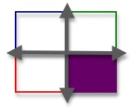
Scenario 4 An integrated tourism sector, but within a South Africa that is uncompetitive with respect to tourism
Collaboration exists within the sector and between the sector and Government
Missing the changing market with the country and the sector underestimating the consumer.
Overpriced
Safety remains a major challenge
South Africa’s over-confidence with respect to its diversity of offerings has resulted in a sector that is not optimised compared to that of other countries that actually have less to offer.

Slide 22
Next Steps
Phase 2 – 2019/2020 - Developing the framework for responding to megatrends and achieving the best case scenario
Considering the implications of the trends for destination management, enterprise management and product development.
Identifying the flags that could change the probabilities in the scenarios
IDEAL RESPONSE
Within a tourism context and more particularly from the perspective of the response of governments and industry to megatrends, the ideal would be to develop a framework that can use the cumulative knowledge of a variety of disciplines against which policy and strategies for a sustainable tourism future can be set.

Slide 23
THANK YOU QUESTIONS?

